Slide 1
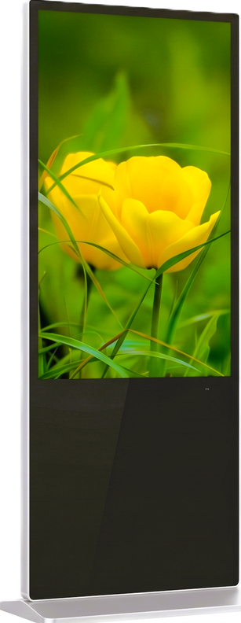
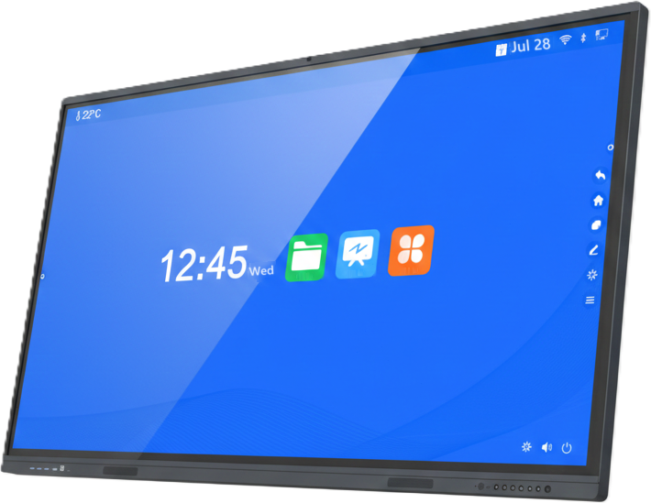
Premium Displays & Visual Technology Solutions
Product
Catalog 2026
Presented by
Shenzhen Xingyicheng Technology Co., Ltd.

Slide 2
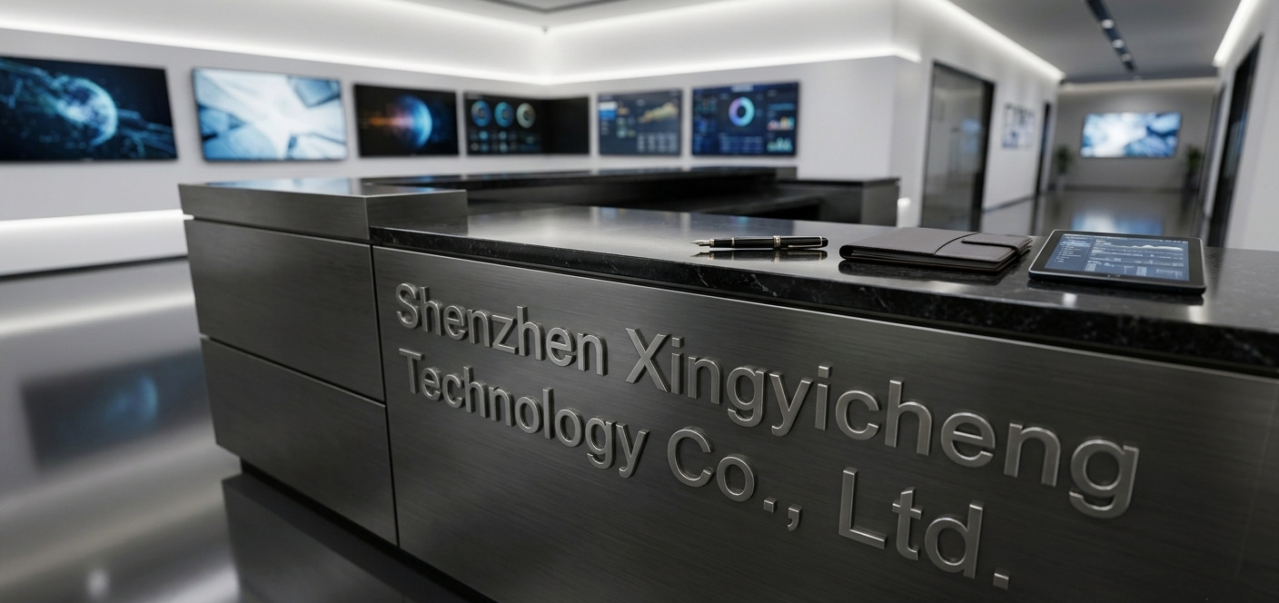
Shenzhen Xingyicheng Technology Co., Ltd.
About Us
About Our Company
Shenzhen Xingyicheng Technology Co., Ltd.
Shenzhen Xingyicheng provides advanced display and electronics solutions, delivering precision-engineered technology to enterprises, retailers, and institutions worldwide. Our mission is to illuminate the future through innovation, quality, and design excellence.
Shenzhen Xingyicheng is an electronics company with its own industrial and factory area. Currently, the company is expanding its business and plans to build a new factory area in Zhongshan.
Since 2008
50–100
RMB 1 million
Display manufacturing
Employees
Registered capital
40,000 m²
80+
3
Own factory area, Shenzhen and Dongguan
Countries exported to
Manufacturing cities
Product Catalog 2026
2

Slide 3



Shenzhen Xingyicheng Technology Co., Ltd.
Capabilities
Design, Manufacturing & Export
We specialize in the design and manufacturing of high performance interactive displays, commercial digital signage, and smart visual solutions.
Product line
Design & engineering
Global export
Interactive whiteboards, LCD video walls, tablets, laptops and AIOT products based on Android and Windows operating systems, with features such as Wi-Fi and 4G LTE connectivity.
With over 15 years of experience in production and export business, we provide comprehensive services such as:
We export our products to more than 80 countries, including South Korea, Japan, Europe, the United States and Australia.
PCBA design
ID design
Hardware and software design
Backed by strict quality control
and comprehensive OEM/ODM support.
Company certifications
Product certifications
The company has obtained certifications such as:
Our products have obtained certifications such as:
ISO 9001
ISO 14001
ISO 45001
KC
TELEC
CE
RoHS
CCC
FCC
CB
Also recognized as a national and Shenzhen
high-tech enterprise.
Product Catalog 2026
3

Slide 4
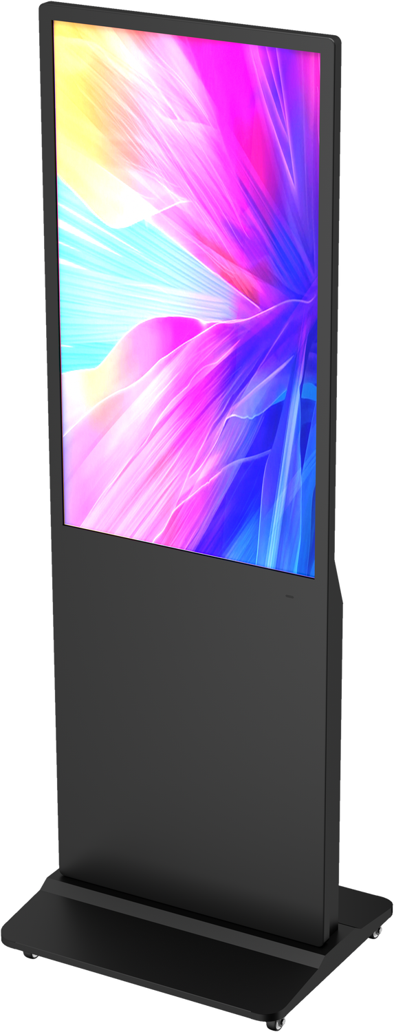
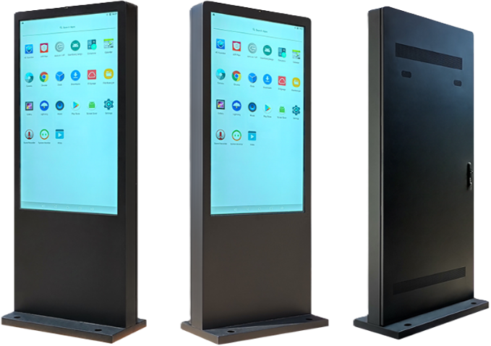
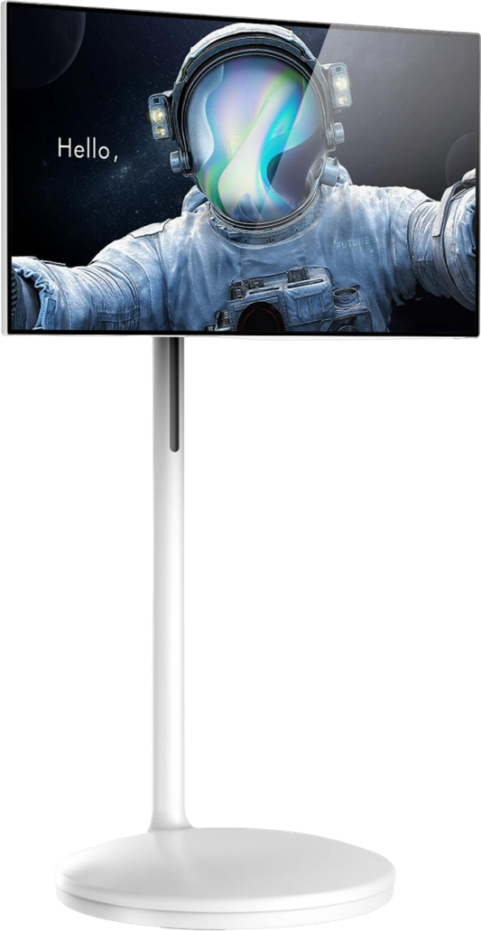
Shenzhen Xingyicheng Technology Co., Ltd.
Product Portfolio
Product Portfolio
Four product lines for education, enterprise, retail and advertising environments.
01
Interactive Displays
02
Digital Signage
4K AI Smartboards, 65" to 110"
Infrared touch · Android + Windows
Also: smart nano blackboard, touch screens, OPS PC module
4K Android advertising displays
Wall-mounted and floor-standing · 32" to 65"
No touch, infrared or capacitive touch
Also: kiosk styles, bar type and OLED displays
Page 05–10
Page 11–13
03
Outdoor Weatherproof Displays
04
Portable Smart Android TV
Ultra bright: 2000–2500 cd/m² · IP55 / IP65
Sizes: 32", 43", 49", 55", 65", 75", 86", 98"
Sizes: 23.8", 27", 32"
Six series, 17 models
MTK8788 or MTK8781 platform
Page 14–15
Page 16–18
Product Catalog 2026
4

Slide 5
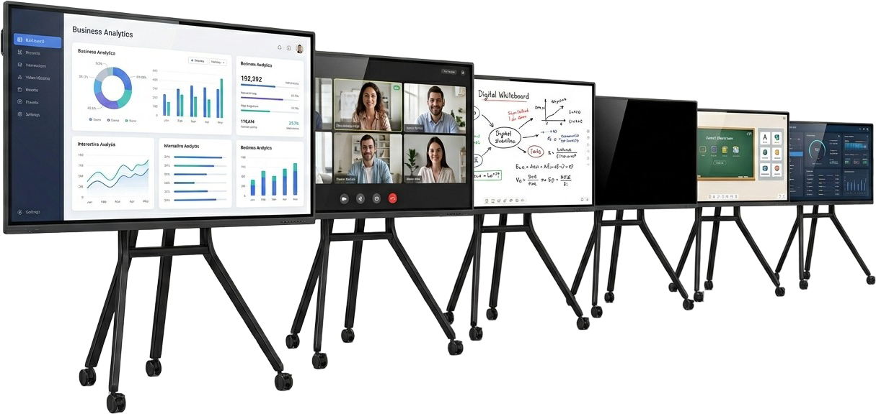
Shenzhen Xingyicheng Technology Co., Ltd.
Product line 01 · Interactive Displays
4K AI Smartboards
Interactive Flat Panel Display (IFPD) · E5 series
Available sizes
65"
75"
85"
86"
98"
100"
110"
4K UHD
40 points
≤ 5 ms
178°
3840 × 2160
Infrared multi-touch
Touch response
Viewing angle
Key features
Zero bonding: near-zero gap between glass and panel, less reflection
4 mm Mohs 7 anti-glare, explosion-proof tempered glass
Write and annotate over any input source
Cast from a PC, iPad or phone: up to 4 screens at once
Three-finger touch turns the screen off
Light sensor and one-touch eye protection
Use cases
Lecture halls
Training centres
Online teaching
Universities and auditoriums
Corporate and vocational courses
Live and recorded remote lessons
Boardrooms
Video conferencing
Workshops
Presentations and reviews
Hybrid meetings with remote teams
Brainstorming and project planning
Product Catalog 2026
5

Slide 6
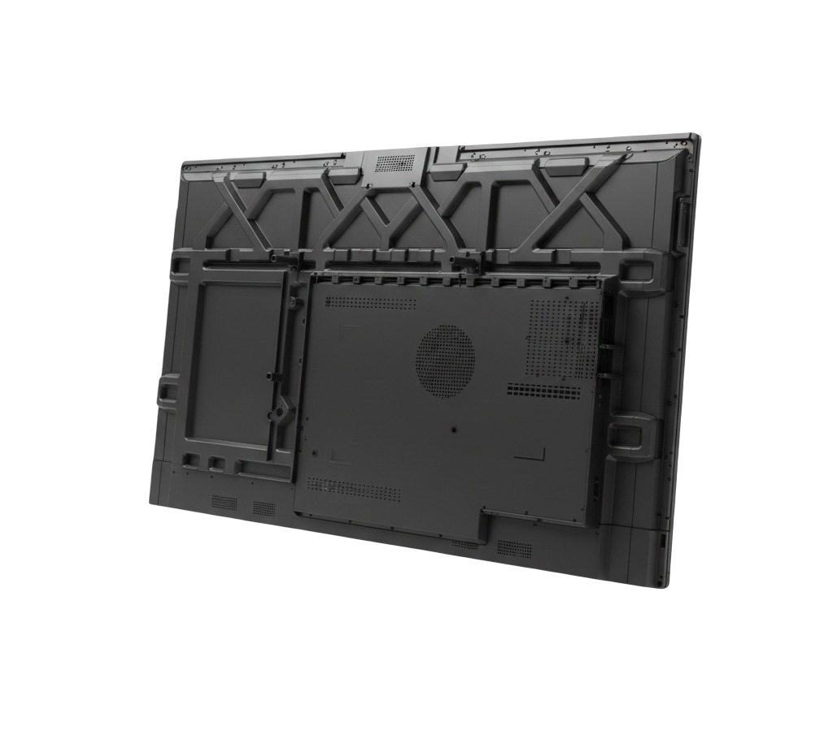
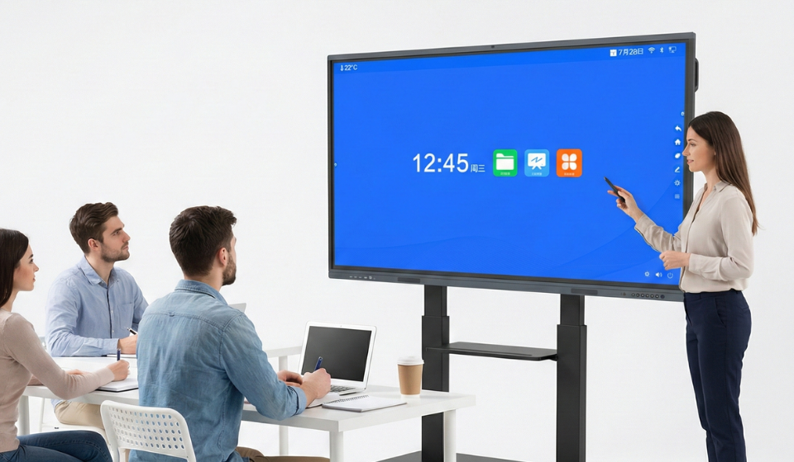
Shenzhen Xingyicheng Technology Co., Ltd.
Interactive Displays
Configurations
E5 series · 12 configurations, each available in every size
Front view
Rear view
Platform | Android | RAM + storage | Mainboard
MT9679 | 14 | 4 + 32 GB · 8 + 128 GB | Simplified
V100 | 13 | 8 + 128 GB | Simplified or full
RK3576 | 16 | 8 + 128 GB · 16 + 256 GB | Simplified or full
RK3588 | 15 | 8 + 128 GB · 16 + 256 GB | Simplified or full
Mainboard options
Simplified board
Full board
The essential ports, for rooms with one main source.
Extra inputs, for rooms that connect several sources.
1 × HDMI in, 1 × HDMI out
1 × LAN, USB, Type-C
Audio in and out, RS232
RK3576: 2 × HDMI in, DP, VGA, 65 W USB-C
RK3588: 3 × HDMI in, DP, VGA, USB-C in
2 × LAN, more USB 3.0 ports
Highlights
Optional camera + 8-array mic
13 or 48 MP, 8–12 m pickup
Speakers
15 W × 2 + 5 W × 2 + 20 W
Wireless
Wi-Fi 6 and Bluetooth
OPS slot
Team training on a mobile stand
Windows PC on MT9679 and RK3576
Product Catalog 2026
6

Slide 7
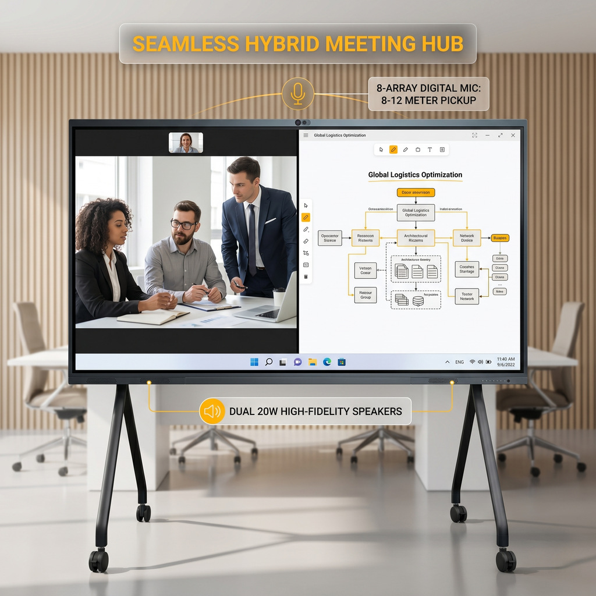
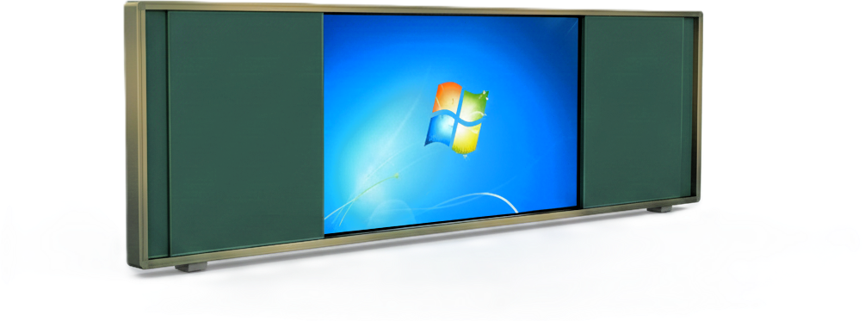
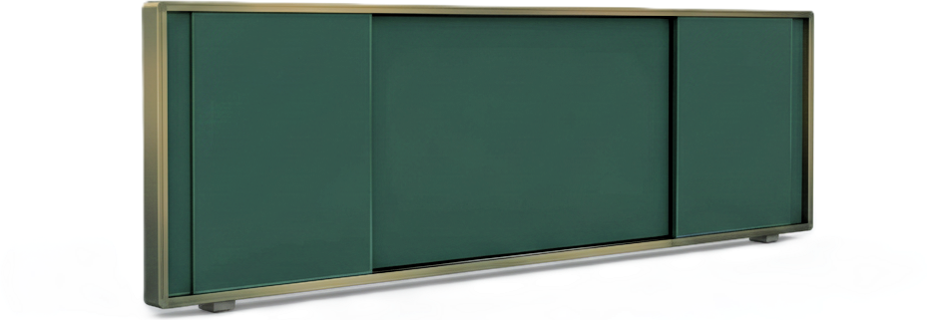
Shenzhen Xingyicheng Technology Co., Ltd.
Interactive Displays
Applications
For Meeting Room
Turn it into
For Classroom
Side boards opened
Side boards closed
Side boards: whiteboard or greenboard surface, sized to match the main display.
Product Catalog 2026
7

Slide 8
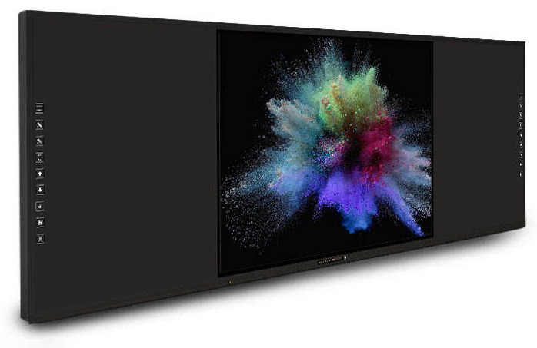
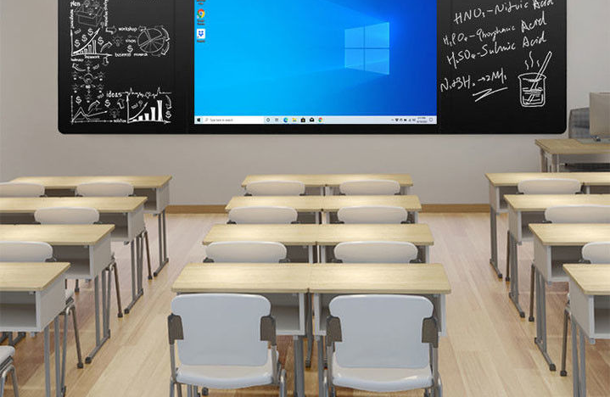
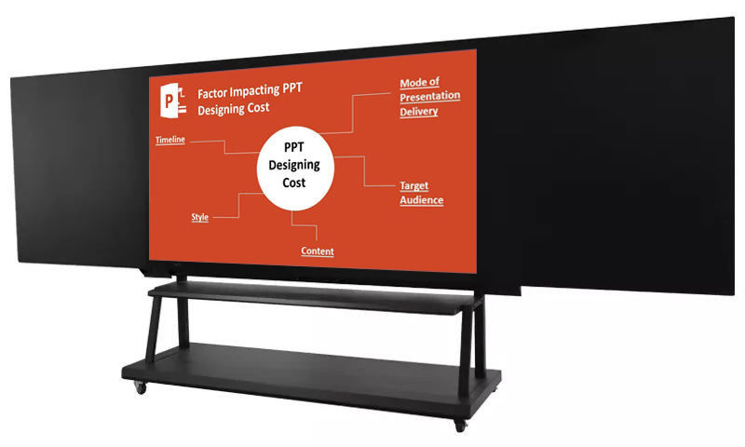
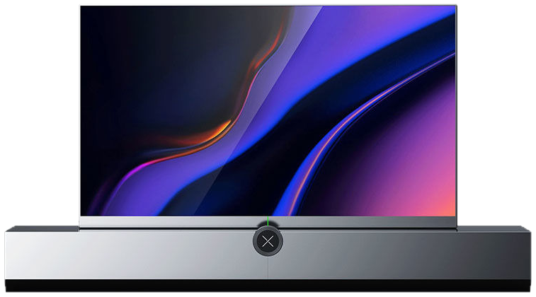
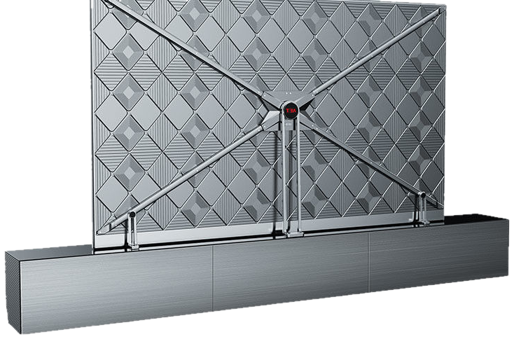
Shenzhen Xingyicheng Technology Co., Ltd.
Interactive Displays
Smart Nano Blackboard
4K touch screen set in a seamless, chalk-writable black board
Wall-mounted in a classroom
On a mobile stand
Available sizes
75"
86"
98"
Display
Touch
Operating system
Side boards
4K UHD · 3840 × 2160
Infrared or capacitive, up to 40 points
Android + Windows
Nano surface, magnetic, chalk trough
Key features
Screen and side boards form one flat, seamless surface
Write with finger, chalk or marker
Replaces a blackboard, projector and computer
Save board notes as PPT, Word, PDF or image files
Product Catalog 2026
8

Slide 9
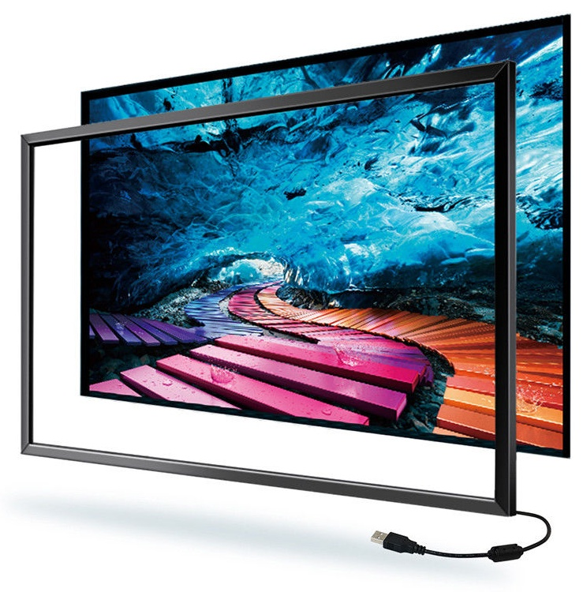
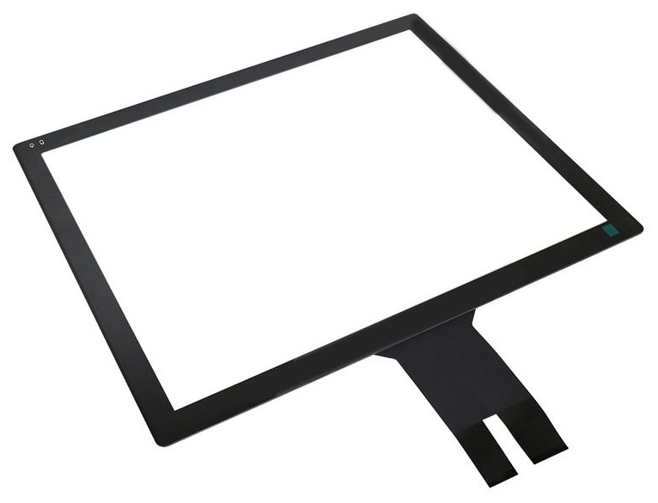
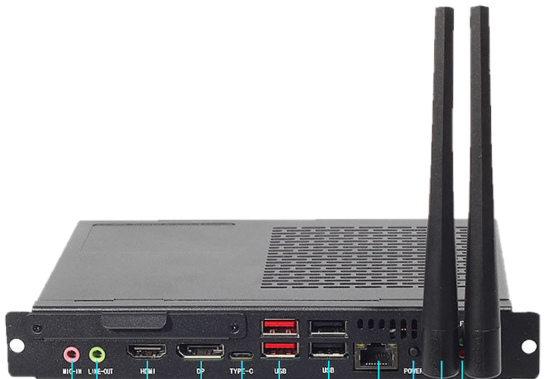
Shenzhen Xingyicheng Technology Co., Ltd.
Interactive Displays
Touch Screens
Infrared touch frames and capacitive touch panels
Infrared touch screen
Capacitive touch screen
Size range | 15" – 65"
Touch points | 10 simultaneous (55" model)
Operating systems | Windows, Linux, Mac OS
Response time | 8 ms
Light transmission | More than 90%
Durability | More than 50 million touches
Interface | USB, RS232, RS485
Power | DC 5 V
Operating temperature | −20 °C to +70 °C
Size range | 15" – 65"
Resolution | 1920 × 1080 (16:9)
Touch | Multi-touch, up to 10 points
Operating systems | Windows 10 / 8 / 7, Android, Linux
Customization | Size and driver IC, OEM/ODM
Certification | CE, FCC, RoHS
Product Catalog 2026
9

Slide 10
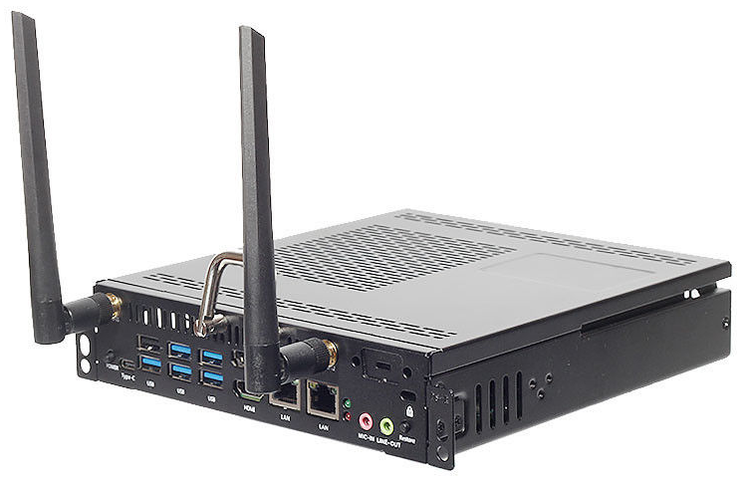
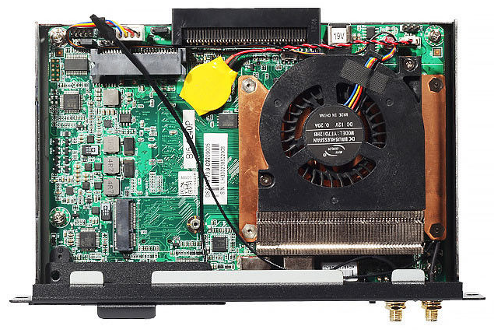
Shenzhen Xingyicheng Technology Co., Ltd.
Interactive Displays
OPS PC Module
Plug-in computer for OPS-slot interactive displays
Plugs into the 80-pin OPS slot of an interactive display and adds a full Windows PC.
Single-slot module
Inside the module
Core i5 / i7 / i9
8 / 16 / 32 GB
128 GB – 1 TB
Intel, 8th to 14th generation
Memory, DDR4 or DDR5
Storage, SSD or HDD
Graphics | Intel Iris Xe (on eligible processors)
Video output | HDMI 2.0 (4K at 60 Hz) and the 80-pin connector; dual or triple display
Ports | 2 × HDMI out, 5 × USB 3.0, 1 × USB 2.0, Type-C, RJ45, audio
Network | Gigabit Ethernet, Wi-Fi 5
Operating system | Windows 10, Windows 11, Linux
Power | 12 V 6.3 A or 19 V 4.7 A (70–80 W)
Operating environment | 0 °C to 45 °C, 10% to 95% humidity
Size and weight | 190 × 190 × 42 mm, 1.2 kg
Fits | OPS-slot smartboards and interactive flat panels
Product Catalog 2026
10

Slide 11
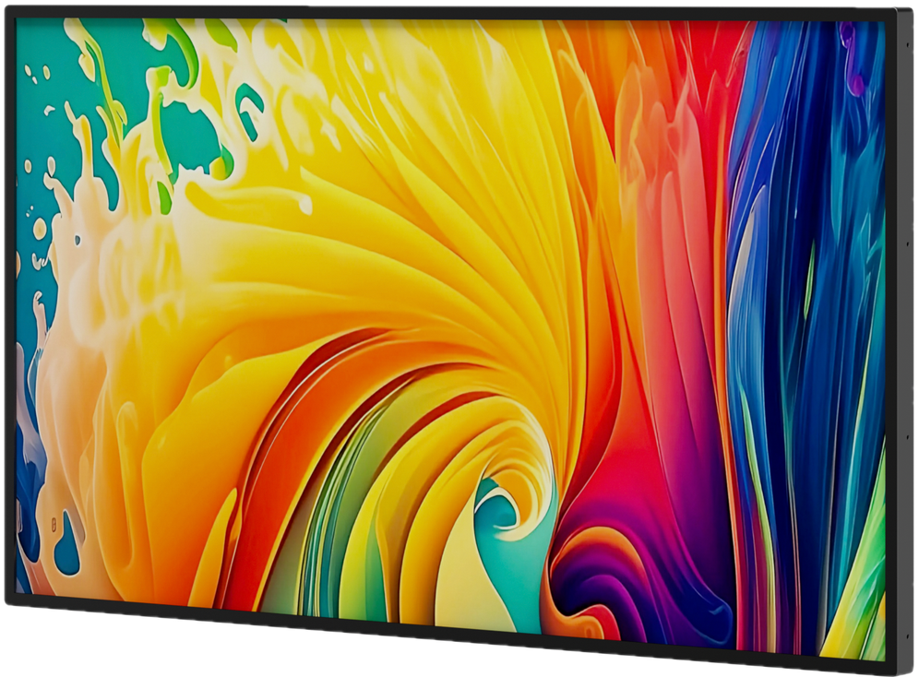
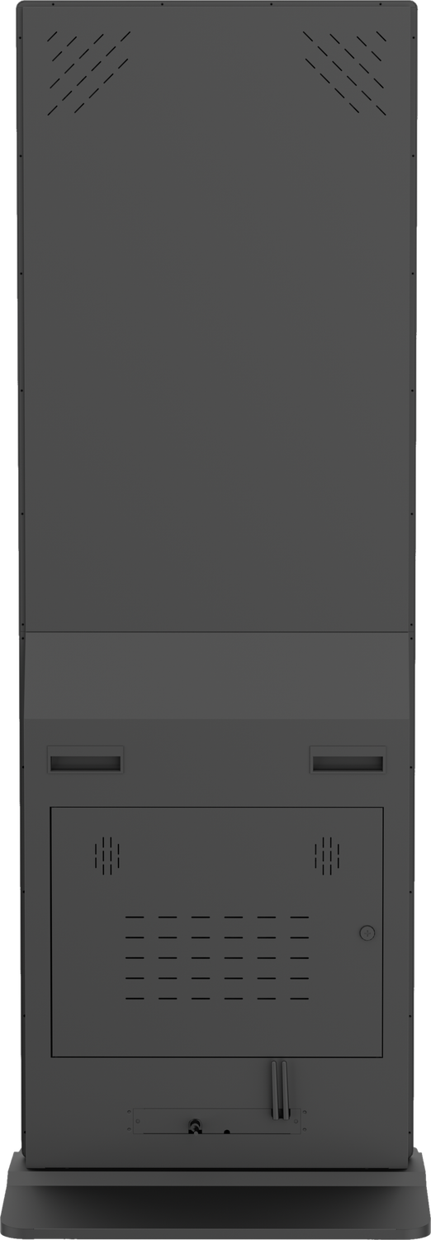
Shenzhen Xingyicheng Technology Co., Ltd.
Product line 02 · Digital Signage
4K Android Advertising Displays
Wall-mounted and floor-standing · with online cloud content management
Wall-mounted · landscape or portrait
Floor-standing
Available sizes
32"
43"
49"
55"
65"
Available in no-touch, infrared or capacitive touch.
Touch points: infrared 10-point, capacitive 10/20-point.
Floor-standing with infrared touch: 43"–65" only (not 32").
Brightness
RAM
Storage
Operating system
350–700 cd/m²
2 / 4 / 8 GB
32 / 64 / 128 GB
Android 9–14
Key features
Built-in CMS for remote publishing: split-screen playback, scheduled power on/off, ad insertion, remote power on/off
Optional self-service terminal modules: facial recognition, NFC card swiping, thermal printing, cameras
All-steel, vandal-resistant and anti-theft body
Modular design for easy maintenance
24/7 operation, plug and play
Custom boot screen and shell logo for OEM orders
Product Catalog 2026
11

Slide 12

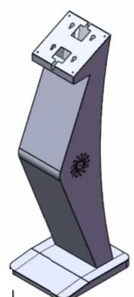
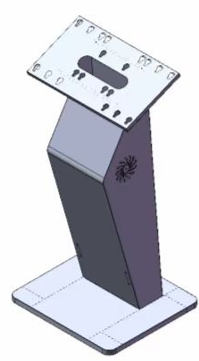
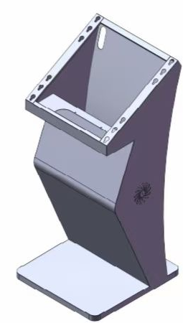
Shenzhen Xingyicheng Technology Co., Ltd.
Digital Signage
Kiosk Styles
Rotating mobile kiosk · K-shaped kiosk stand
Rotating mobile kiosk
The screen rotates between landscape and portrait, and the cabinet base rolls on casters, so the display moves to where the foot traffic is. Plug and play.
Sizes
32" to 65"
Touch
No touch, infrared or capacitive
Content
Cloud CMS, remote publishing
Ideal for
Exhibitions
Pop-up stores
Events
K-shaped kiosk stand
An angled pedestal that turns a display into a stand-alone kiosk, in three sizes.
Small · 15.6" to 27"
Medium · 32"
Large · 43" to 65"
Stand | Fits screens | Weight
Small | 15.6" to 27" | 11 kg
Medium | 32" | 13 kg
Large | 43" to 65" | 19 kg
Colours: black, white or silver.
Product Catalog 2026
12

Slide 13
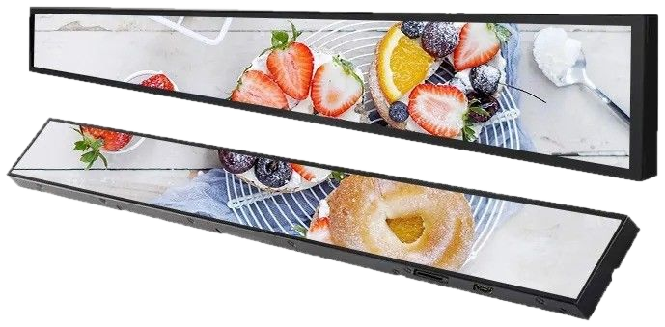
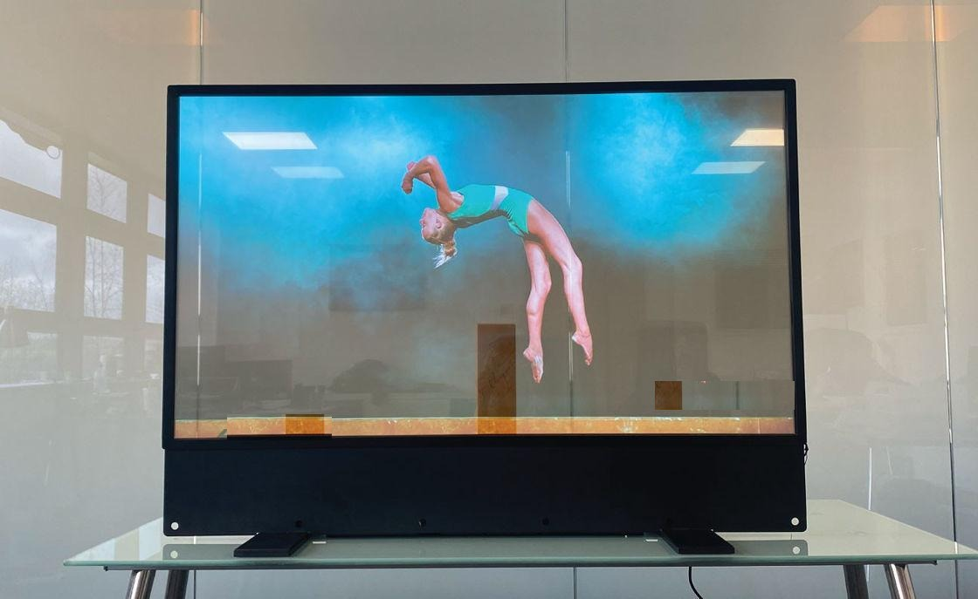
Shenzhen Xingyicheng Technology Co., Ltd.
Digital Signage
Bar Type and OLED Displays
Stretched bar LCD · transparent OLED
Bar type digital signage · 32" – 65"
Resolution | 3840 × 2160
Brightness | 350–500 cd/m²
Operating system | Android / Windows
Installation | Wall-mounted or floor-standing
OLED transparent display
Transparent, flexible OLED screen
Ultra-thin construction
Full-colour display
Customizable size, colour gamut, pixel pitch and interface
Applications
Augmented reality
Interactive displays
High-tech retail fixtures
Product Catalog 2026
13

Slide 14
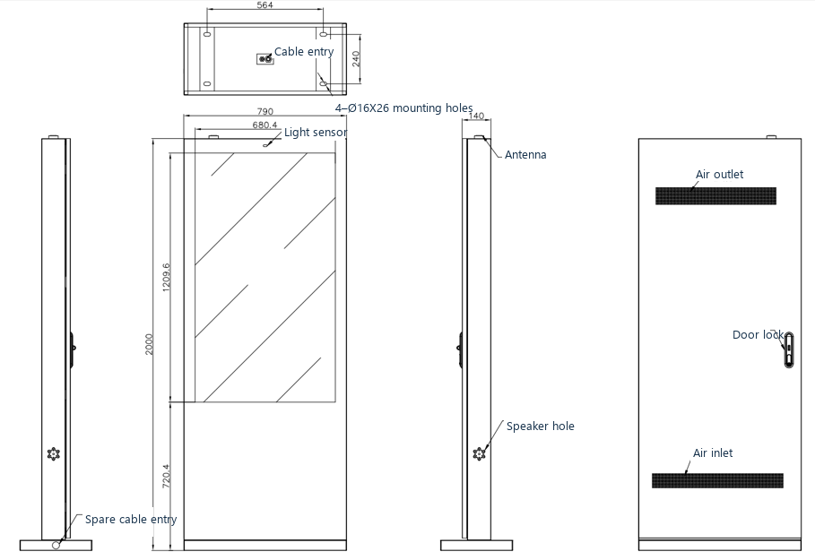
Shenzhen Xingyicheng Technology Co., Ltd.
Product line 03 · Outdoor Displays
Ultra Durable Outdoor Weatherproof Advertising Displays
Brightness
2000–2500 cd/m²
Protection
IP55 or IP65
Operating temperature
−30 °C to +50 °C
Front glass
6 mm tempered
Available sizes · wall-mounted or floor-standing
32"
43"
49"
55"
65"
75"
86"
98"
Brightness: 2000 cd/m² on 32"–65", 2500 cd/m² on 75"–98".
Cooling options
Air-cooled · IP55
Air conditioner · IP65
Intelligent temperature control with axial fans
Built-in air conditioner for stronger protection
Key features
Clear in direct sunlight, no reflection issues
Works in rain, dust and strong wind
Built for 24/7 continuous operation
Accessible interior for quick repairs
Product Catalog 2026
14

Slide 15
Shenzhen Xingyicheng Technology Co., Ltd.
Outdoor Weatherproof Displays
Construction & Dimensions
Ultra durable outdoor weatherproof advertising displays
Dimensional drawing · 55" floor-standing model, mm
Overall 790 × 2000 × 140 mm (W × H × D); screen area 1209.6 × 680.4 mm.
Build, protection and service
Front glass | 6 mm tempered, 3–5× stronger than ordinary glass
Housing | Galvanized steel, zinc-rich primer, outdoor powder coating
Electrical safety | Air switch, lightning protector, leakage protection
Scheduled power | Time-control switch, several on/off periods per day
Testing | Water spray, high and low temperature, simulated solar radiation
Warranty | 1 year
Packaging | Wooden frame; export wooden box optional
Product Catalog 2026
15

Slide 16
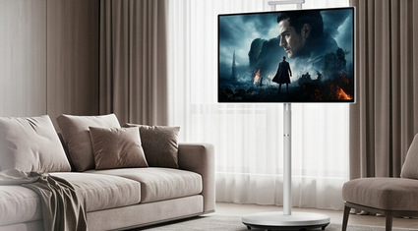
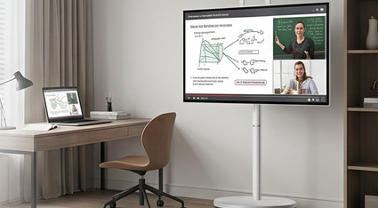
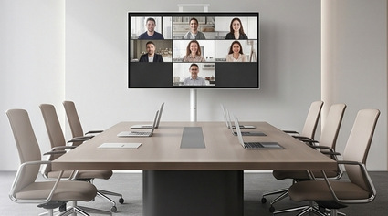
Shenzhen Xingyicheng Technology Co., Ltd.
Product line 04 · Portable Smart TV
Portable Smart Android TV
Available sizes
23.8"
27"
32"
HK series: 27" and 32" only.
Configurations (all models)
4GB + 64GB
6GB + 128GB
8GB + 128GB
Key features
Built-in or clip-on camera, by series
10-point capacitive touch screen
MTK8788 (Android 13) or MTK8781 (Android 15)
Mobile stand with smooth movement (all except HL)
Perfect for
Home Entertainment
Online Learning
Business Meetings
Enjoy movies, streaming and family entertainment anywhere.
Interactive learning, online classes and remote education.
Perfect for presentations, collaboration and video meetings.
Product Catalog 2026
16

Slide 17
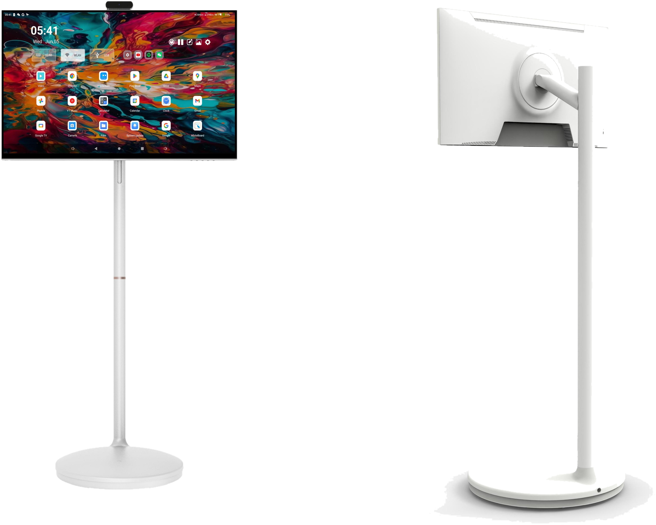
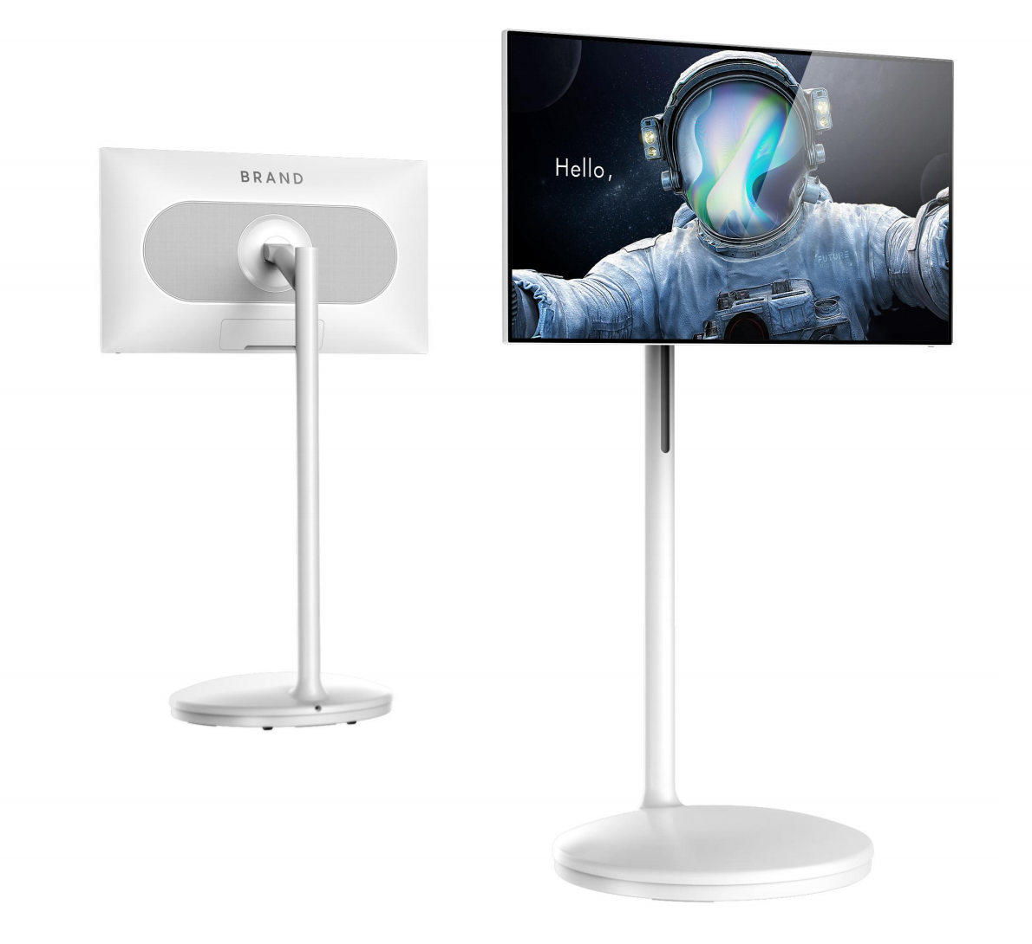
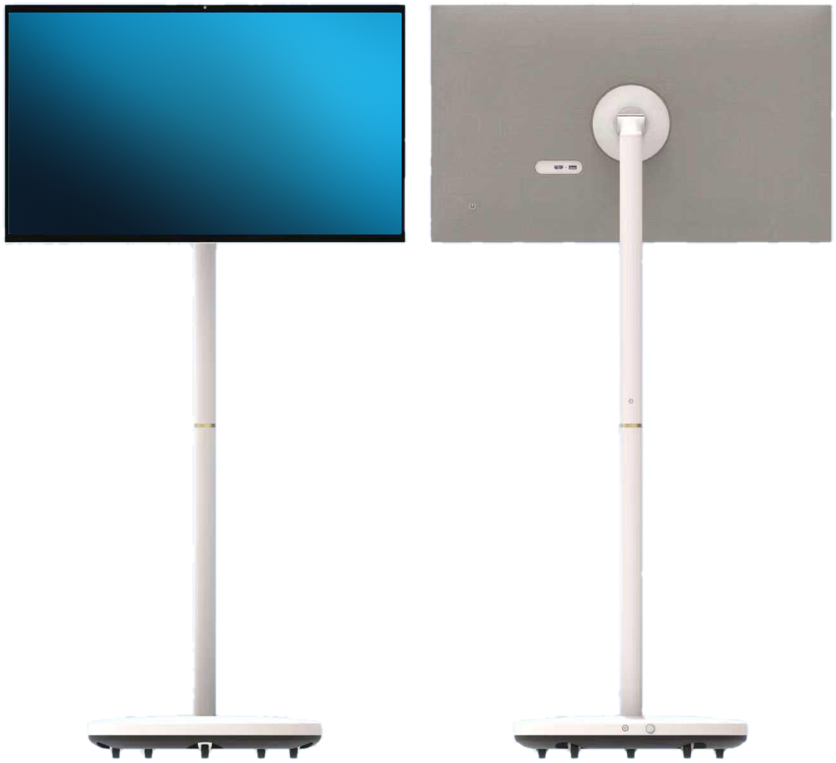
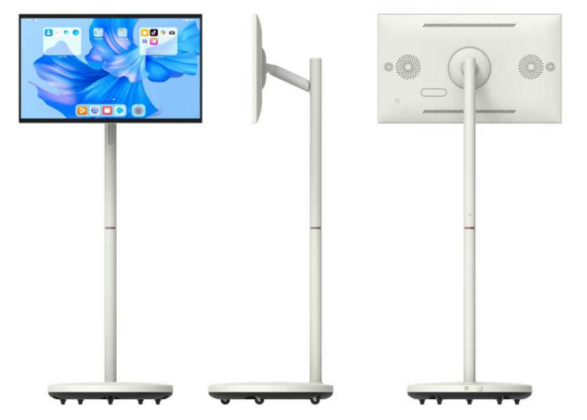
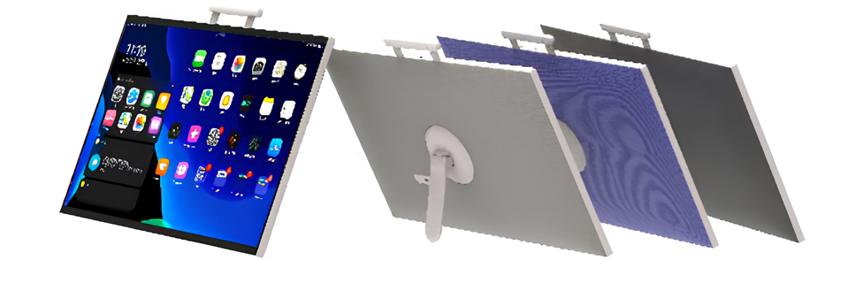
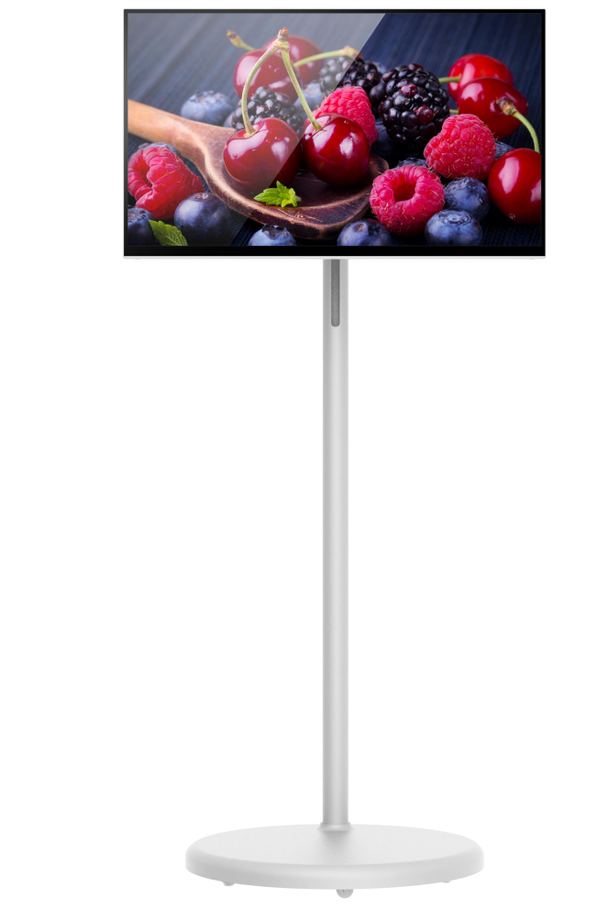
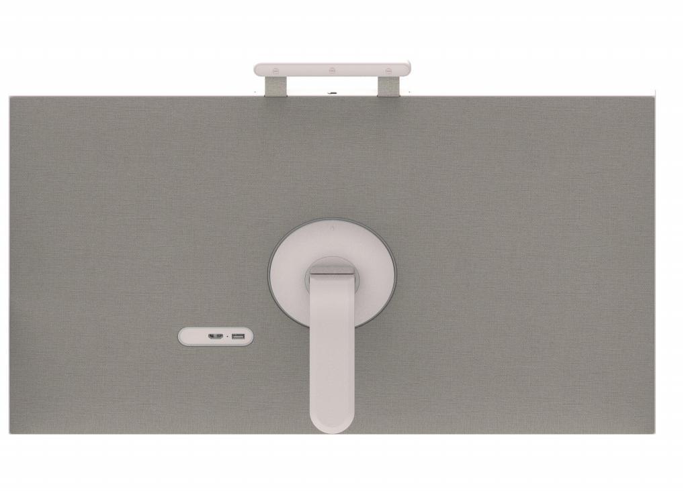
Shenzhen Xingyicheng Technology Co., Ltd.
Portable Smart Android TV
Six Series, 17 Models
One Android TV family, six finishes and stands
HY Series
HK Series
Plastic-texture finish
Half-fabric cover
23.8"
27"
32"
27"
32"
HS Series
HP Series
Full-fabric cover
Leather-texture finish
23.8"
27"
32"
23.8"
27"
32"
HL Series · Desktop display
HS 2-in-1 Series · Detachable display
Display only, no floor stand
Base with 5 silent casters
23.8"
27"
32"
23.8"
27"
32"
HY, HK, HS, HP and HS 2-in-1
HL Series
Fully laminated screen on HY
Full HD display
Adjustable height, tilt and rotation
Rechargeable lithium battery: 10,000 mAh
Fully laminated screen
Whiteboard software, screen mirroring software and remote control included
Supports custom mold development
Rechargeable lithium battery: 5,000 mAh (23.8"), 10,000 mAh (27", 32")
Product Catalog 2026
17

Slide 18
Shenzhen Xingyicheng Technology Co., Ltd.
Portable Smart Android TV
Platform & Specifications
What differs by series
Platform
MTK8788 · Android 13
MTK8781 · Android 15
Standard platform
Newer platform
HY
HK
HS
HP
HS 2-in-1
HY
HK
HS
HP
HL
Camera
5 MP clip-on
13 MP built-in
Magnetic mount, with microphone
Integrated in the frame
HY
HK
HS
HP
HL
HS 2-in-1
Stand movement · HY, HK, HS, HP, HS 2-in-1
±25°
±90°
Tilt, forward and back
Rotation, portrait to landscape
Connectivity
Ports
Carry bag
Wi-Fi · Bluetooth
HDMI in · Type-C · 3.5 mm audio
Optional for HS; custom logo on bulk orders
Packaging
Bulk orders
PE bag, rigid carton, high-density foam
Shipped in full cartons or pallets
HS 2-in-1 shipping
Detachable, flat-packed design: smaller cartons, lower freight, more units per container
Product Catalog 2026
18

Slide 19
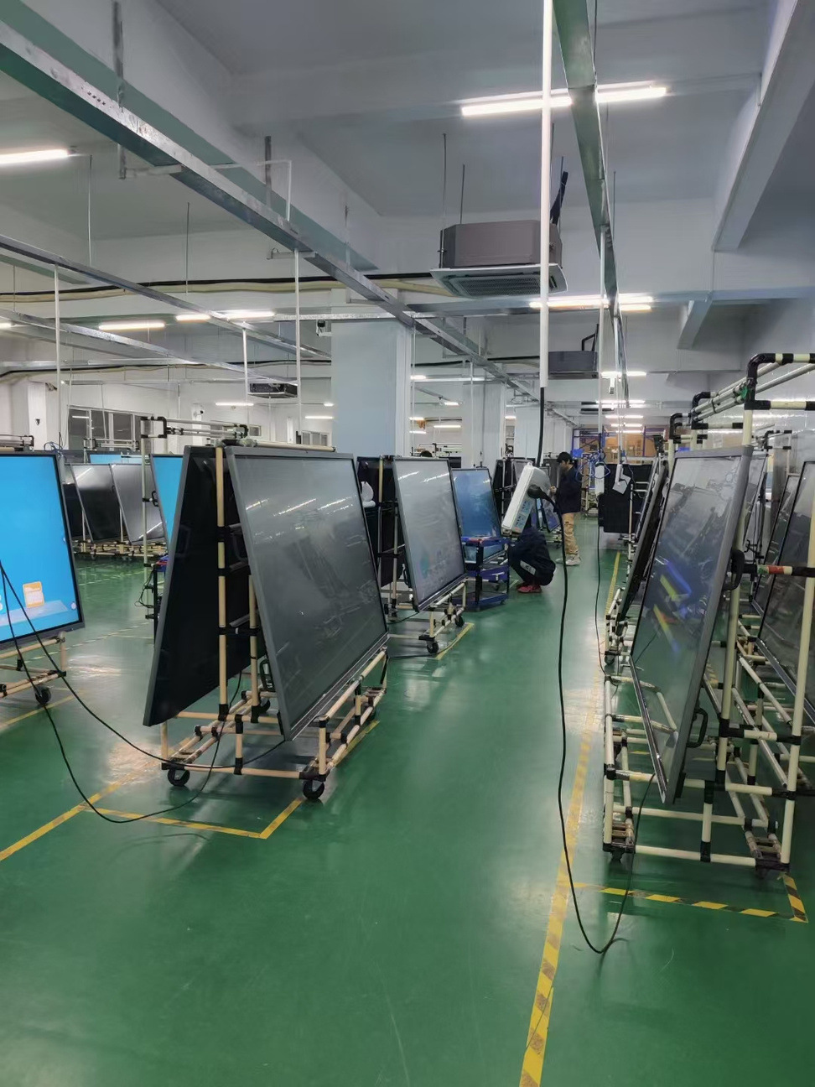
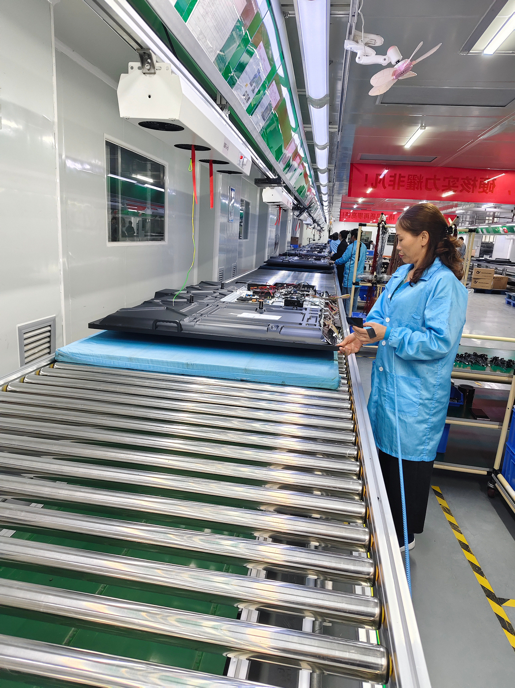
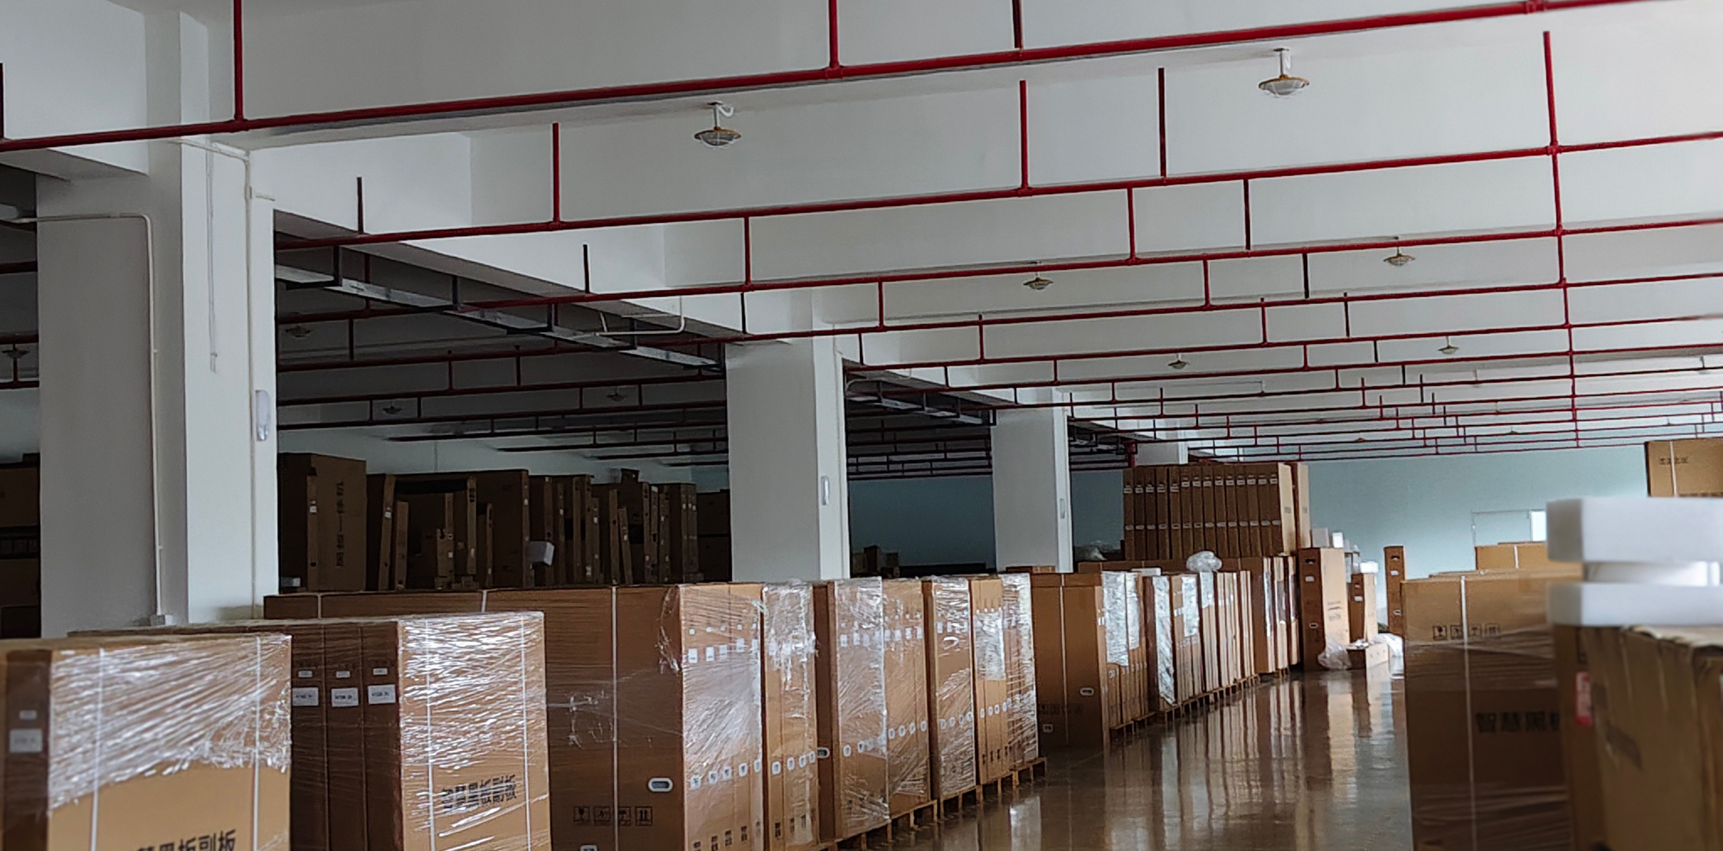
Shenzhen Xingyicheng Technology Co., Ltd.
Manufacturing
Factory & Production
Our own industrial and factory area in Shenzhen and Dongguan covers 40,000 square meters. The company is expanding its business and plans to build a new factory area in Zhongshan.
Factory
Assembly Line
Warehouse
Product Catalog 2026
19

Slide 20

Shenzhen Xingyicheng Technology Co., Ltd.
Contact
Contact Information
We are here to assist you. Reach out to our team for product inquiries, partnership opportunities, or support. Our dedicated team is ready to provide the premium service you deserve.
Address
Room 203, Building B, No. 115 Guangqiao North Road, Xinqiang Community, Xinhu Street, Guangming District, Shenzhen
Phone
+86 188 2465 6358
+86 136 3150 4323
+86 199 2644 2018
Scan for WhatsApp
Email
Admin@xyc-ltd.com
lzz@xyc-ltd.com
Antony@xyc-ltd.com
Website
https://www.interactiveswhiteboard.com/
Product Catalog 2026
20

